Slide 1
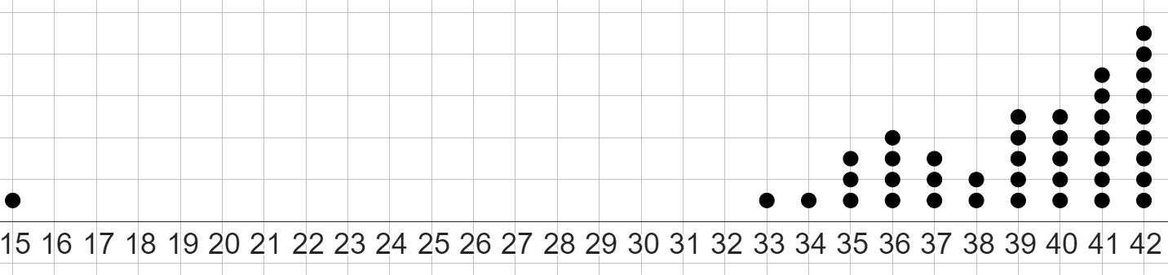
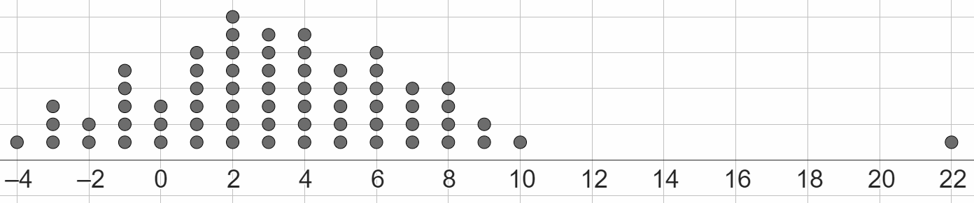
Evaluating the range
Task A: Outliers and their effect on the range
1)
a) Circle the outlier in this dataset.
b) What is the original range of this dataset?
c) If a data point for the number 39 was removed, by how much would the range change? Explain your answer.
d) Remove the outlier from the dataset. Calculate the new range.
2)
a) Circle the outlier in this dataset.
b) What is the original range of this dataset?
c) If a data point for the number −4 was removed, by how much would the range change? Explain your answer.
d) Remove the outlier from the dataset. Calculate the new range.

Slide 2
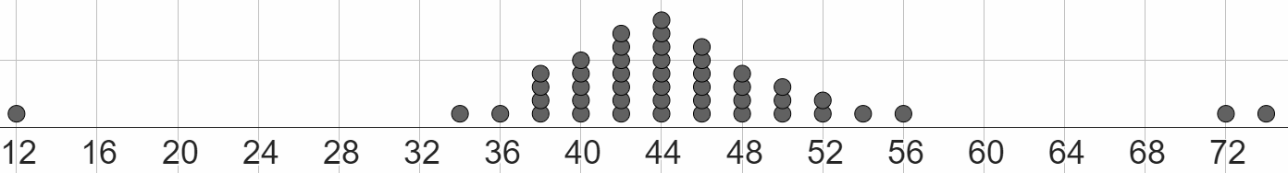
Evaluating the range
3) All data points in this dataset are even numbers.
a) What are the values of the three outliers?
b) By how much would the range decrease by if all the outliers were removed?
1.5 | 14.5 | 16.9 | 21 | 24.2 | 28.3 | 31.9 | 33.8 | 37.7 | 38.8 | 39.9 | 42.5 | 45.2 | 46.8 | 82.5
4) Complete each sentence with a number from the dataset:
the original range is
removing the data point 37.7 will change the new range to
if the smaller outlier was removed from the original dataset, the new range would be
if the larger outlier was removed from the original dataset, the new range would be
the outlier that would be more impactful to remove is

Slide 3
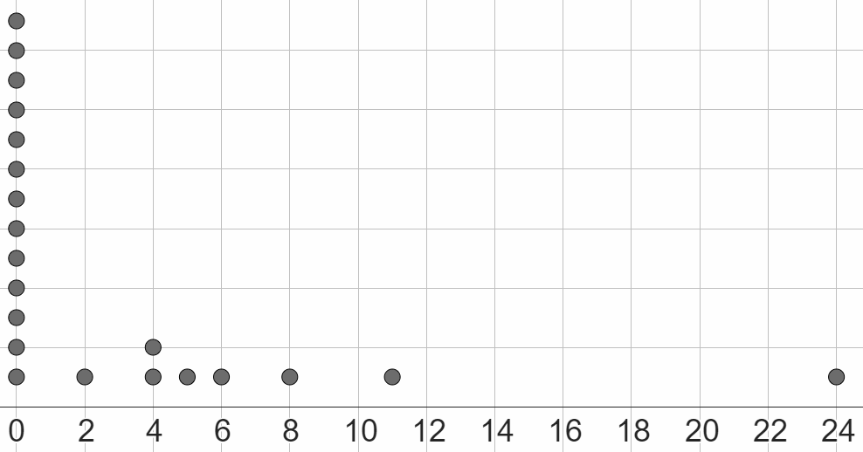
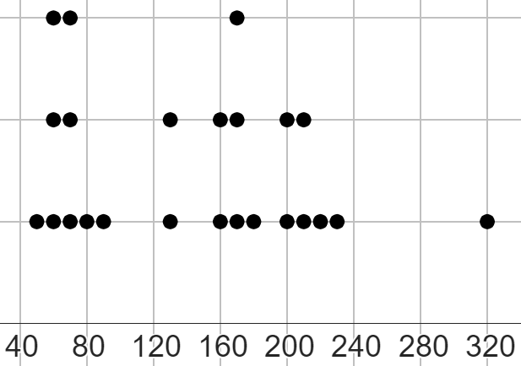
Evaluating the range
Task B: Evaluating if removing outliers is sensible
1) This dot plot shows the number of days per month that had airfrost (due to cold weather) in Leuchars (Scotland) over a 21 month period.
a) What is the value of the outlier?
b) Should the outlier be: removed, kept, or investigated further?
Write a sentence to explain the option you have chosen.
2) This dot plot shows the number of “hours of sunshine” per month for two years, rounded to the nearest 10 hours.
a) What is the value of the outlier?
b) All data points have been correctly measured, with no error.
Should the outlier be: removed, kept, or investigated further?
Write a sentence to explain the option you have chosen.
3) This dataset shows the height of 24 chimpanzees, in centimetres.
1.4 | 95 | 103 | 108 | 108 | 111 | 114 | 117
118 | 118 | 124 | 125 | 129 | 132 | 135 | 138
130 | 138 | 150 | 153 | 161 | 166 | 172 | 198
a) What is the current range of this dataset?
b) What is the value of the outlier or outliers in this dataset?
c) Should the outlier or outliers be: removed, kept, or investigated further?
Write a sentence to explain the option you have chosen, and justify it by calculating any new range that might happen from you removing any outliers.

Slide 4
Evaluating the range
4) This dataset accurately shows the total monthly rainfall (in millimetres) each month for two years, between 2007 and 2008.
285.6 | 60
154 | 58.3
146.9 | 57.5
113 | 56.7
108.7 | 52.8
98.8 | 48.7
93.2 | 44.5
92.4 | 43.5
83.8 | 28.1
82.6 | 27.1
79.2 | 23.3
74.9 | 5.8
Jun wants to represent this dataset on a dot plot, and wants to see if removing any outliers has an impact on the range of the data he has to plot.
Calculate two ranges, with one keeping the outliers, and one removing an outlier, and suggest if Jun should represent all data points on a dot plot or not.
Mathematics Education and Industry
v2.1

